Slide 1
Sound isn’t real….

Slide 2
Sound isn’t real….
Or maybe easier….
Representations of sound aren’t real.

Slide 3
Sound isn’t real….
Or maybe easier….
Representations of sound aren’t real.
Any measurement of sound that we see in our work is an abstraction/simplification/or 2nd order measurement etc. Some more representative of perception than others, but still an abstraction. Why?!

Slide 4
Sound exists in time and frequency.
Any measurement must be an average across some of these dimensions. Not a ‘real’ representation of sound as perception.

Slide 5
Sound exists in time and frequency.
Any measurement must be an average across some of these dimensions. Not a ‘real’ representation of sound as perception.
Whereas the auditory system is just doing this. It doesn’t care if things are measurable. It’s job is to listen, not measure.
It is better than we are, and we should feel bad about that.

Slide 6
Why are you doing this to us?
Inspired by a paper that said (heavily paraphrased)
“The stimuli were similar in a mathematical sense”

Slide 7
Why are you doing this to us?
Inspired by a paper that said (heavily paraphrased)
“The stimuli were similar in a mathematical sense”…

Slide 8
Why are you doing this to us?
Inspired by a paper that said (heavily paraphrased)
“The stimuli were similar in a mathematical sense”… ……

Slide 9
Why are you doing this to us?
Inspired by a paper that said (heavily paraphrased)
“The stimuli were similar in a mathematical sense”… ……

Slide 10
WE DON’T HAVE A MATHEMATICAL SENSE
engineers are not made happy by this information. Be careful.

Slide 11
Auditory Illusions!
Our auditory system must break down variations in air pressure to understand the world around us, for our benefit. Not for maths.
It has to cheat (that’s why it’s better than us)
Auditory illusions are the fringe cases of the auditory system dealing with an extraordinarily complex task.
(there’s obviously many more ways that mathematical representations are not perceptual representations, but these are more fun)

Slide 12
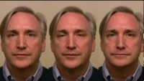
Auditory Illusions
You’re all familiar with McGurk effect?

Slide 13
Auditory Illusions
You’re all familiar with McGurk effect?
But Huw, that’s obvious why the auditory system is fooled. Surely the fundamentals of sound like pitch can’t suffer drastic, mind bending effects of perceptual change, right?

Slide 14
Auditory Illusions
You’re all familiar with McGurk effect?
But Huw, that’s obvious why the auditory system is fooled. Surely the fundamentals of sound like pitch can’t suffer drastic, mind bending effects of perceptual change, right?
….I thought you might say that…

Slide 15

Shepherd Tone
A sound can’t fall forever right? It must surely get too low to hear?

Slide 16
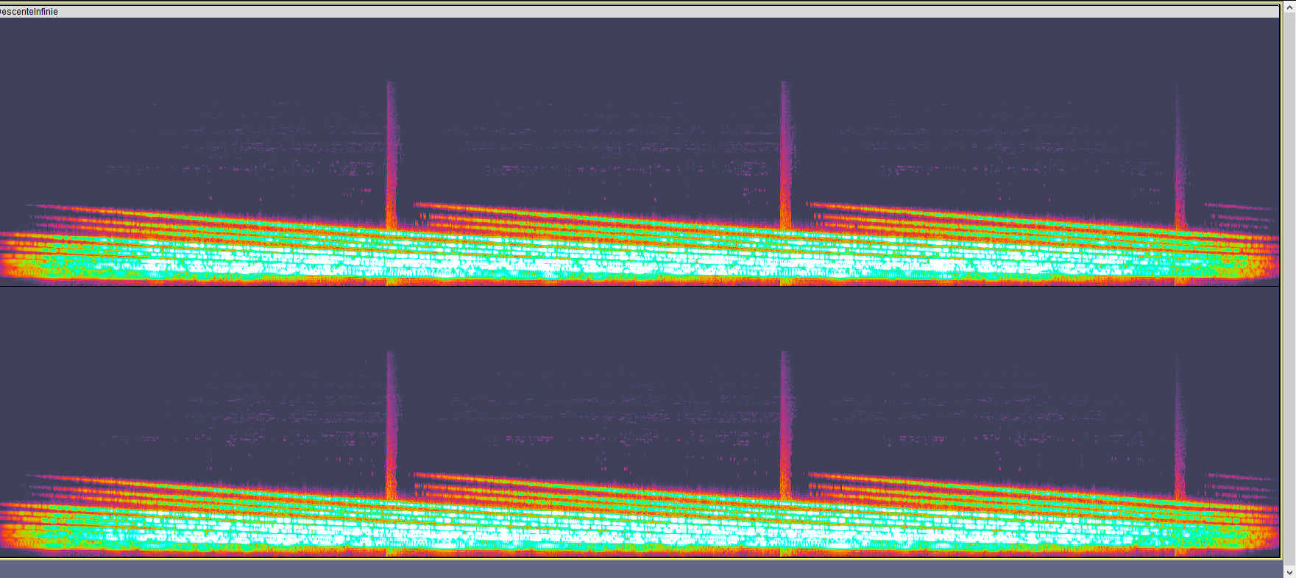
Shepherd Tone
It’s a repeating series of ‘unstable’ tones that descend.
Perceptually however, it’s one ‘object’. Hence this infinite falling illusion. In a mathematical sense, this stays constant.

Slide 17
Shepherd Tone
We don’t know Huw, that still seems pretty extreme a manipulation…

Slide 18
Shepherd Tone
We don’t know Huw, that still seems pretty extreme a manipulation…
Do you want me to open MATLAB 2021b?

Slide 19
Shepherd Tone
We don’t know Huw, that still seems pretty extreme a manipulation…
Do you want me to open MATLAB 2021b?
No….

Slide 20
Shepherd Tone
We don’t know Huw, that still seems pretty extreme a manipulation…
Do you want me to open MATLAB 2021b?
No….
Don’t care…

Slide 21
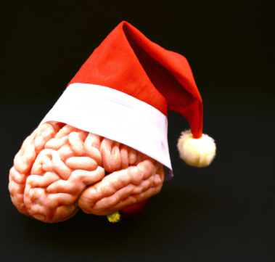
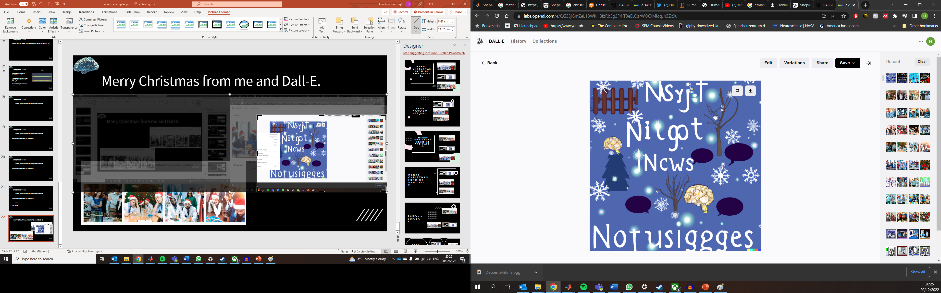
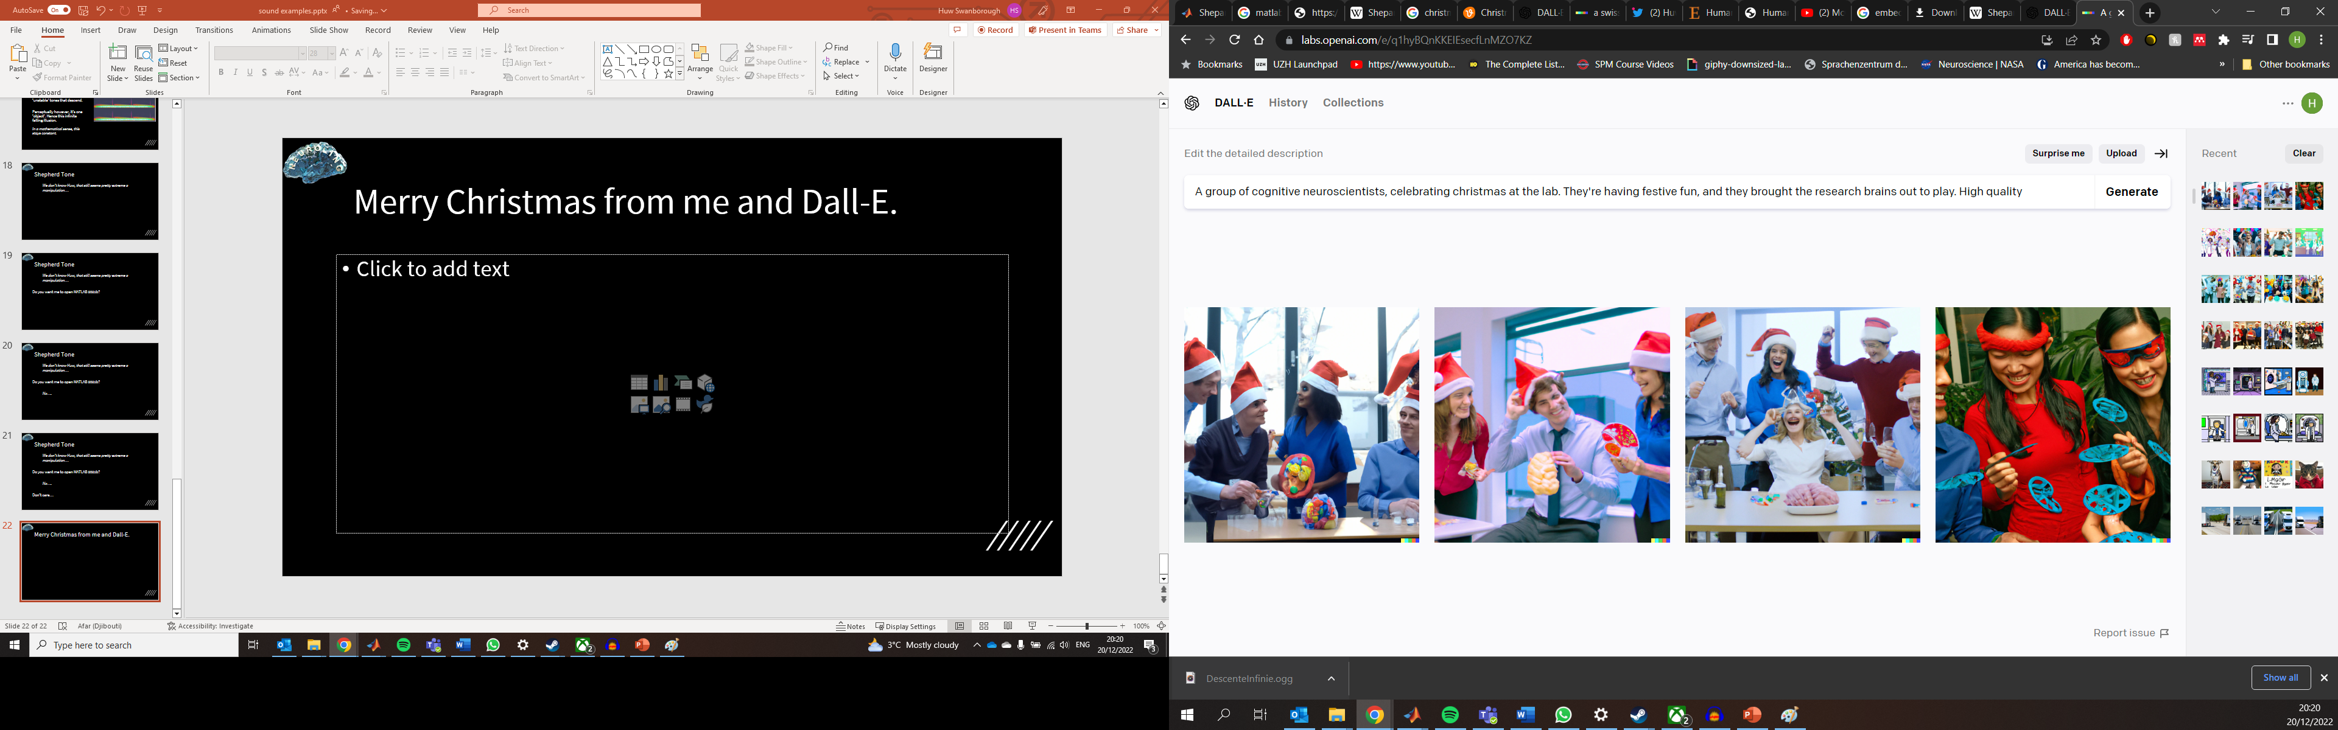
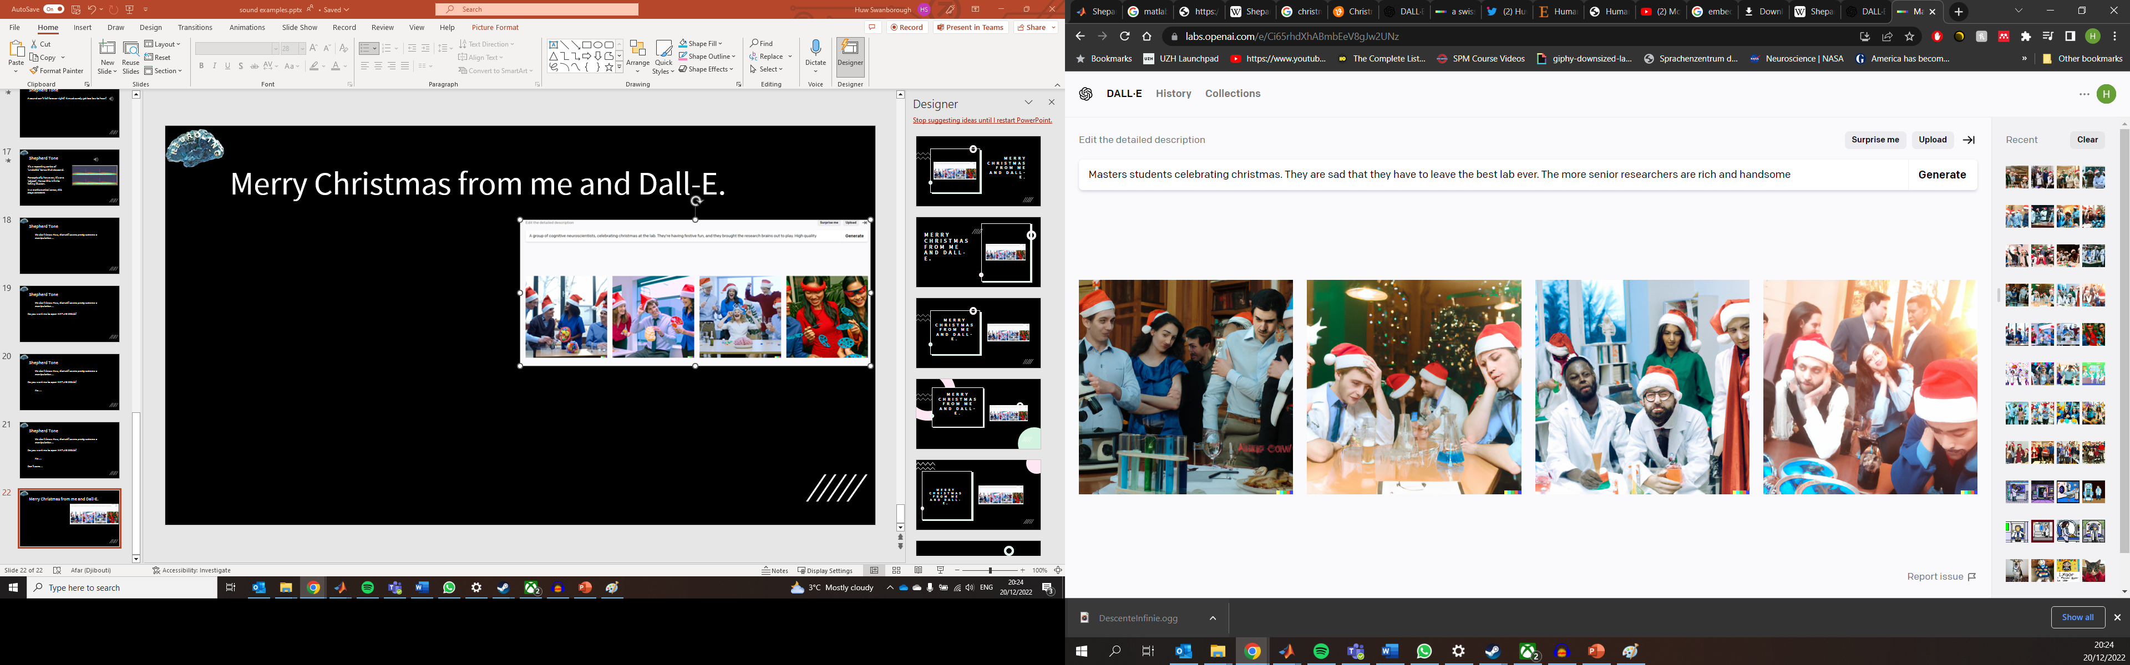
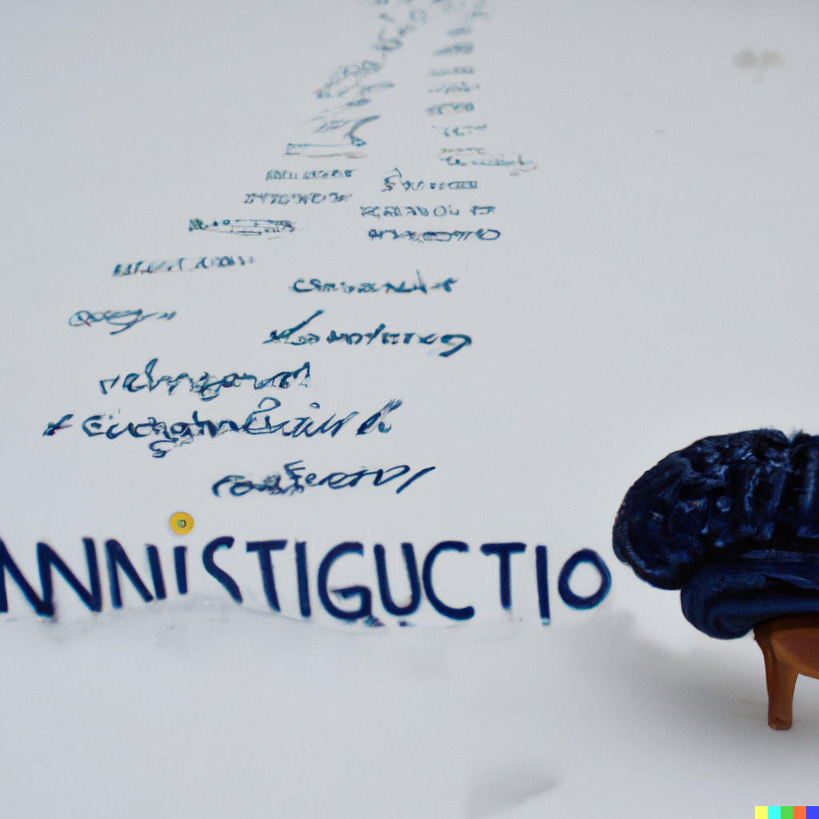
Merry Christmas from Dall-E and Me!
A Christmas card for neurolinguists.
Neurolinguistics in the snow

Slide 22
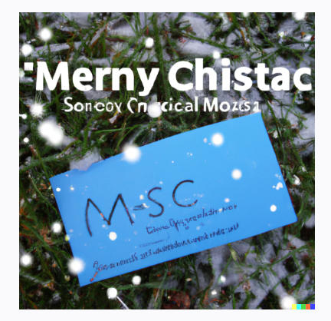
Merny Chistac and Soncox Cnocical Mozis1
A Christmas card for MSc Students.

